Slide 1
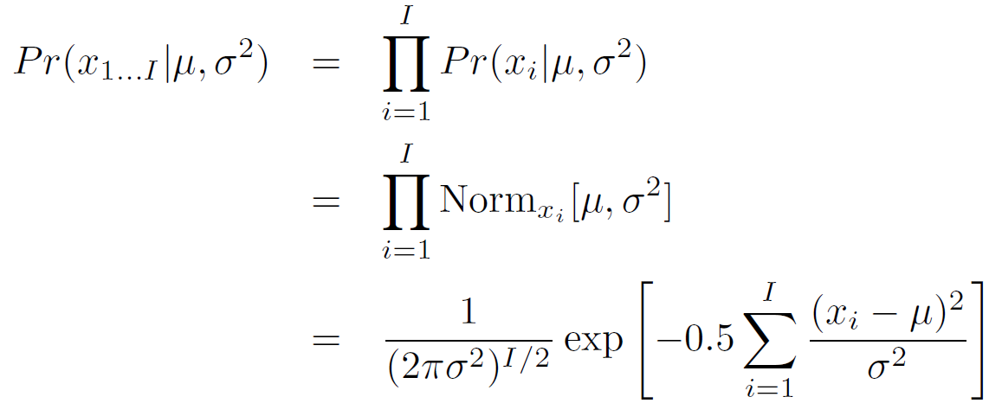
Fitting normal distribution: ML

Slide 2
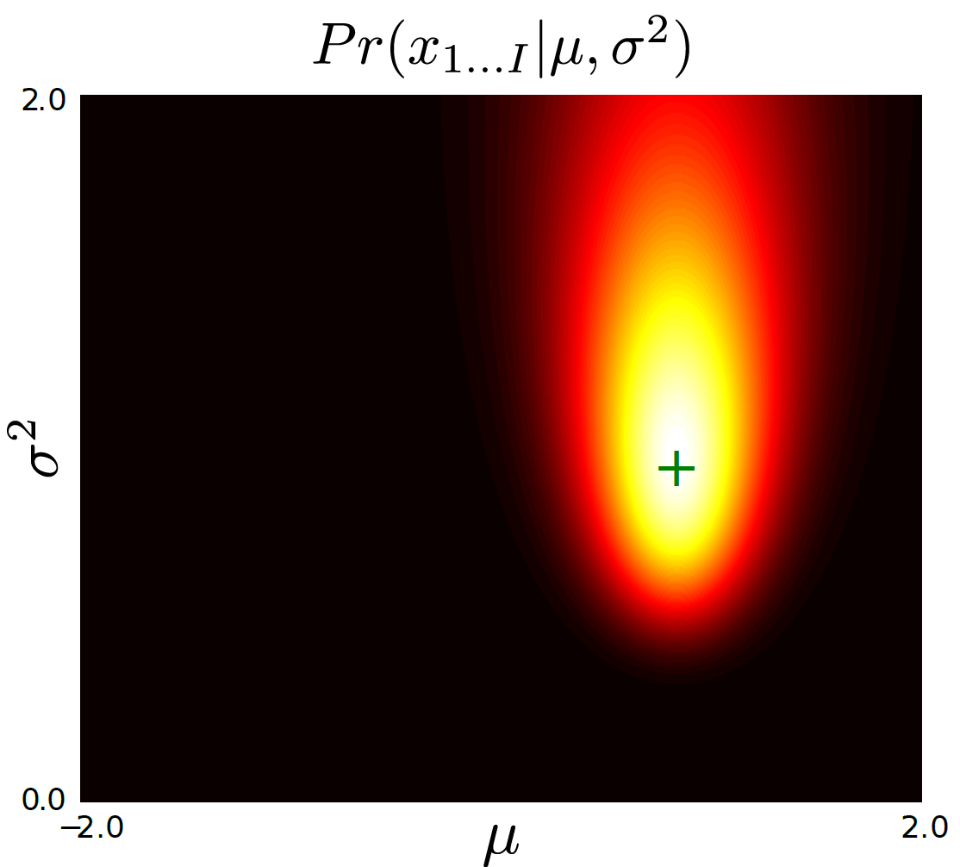
Fitting a normal distribution: ML
Plotted surface of likelihoods as a function of possible parameter values
ML Solution is at peak

Slide 3
Predicting the world
We need a model that mathematically relates input data x (e.g. visual data) and output data t (e.g. world state). The model specifies a family of possible relationships between x and t and the particular relationship is determined by the model parameters w.
We need a learning algorithm that allows us to fit the parameters w using paired training examples {x_{i},t_{i}} where we know both the measurements and the underlying state.
We need an inference algorithm that takes a new observation x and uses the model to return the posterior P(t|x,w) over the state t. Alternately, it might return the MAP solution or draw samples from the posterior.

Slide 4
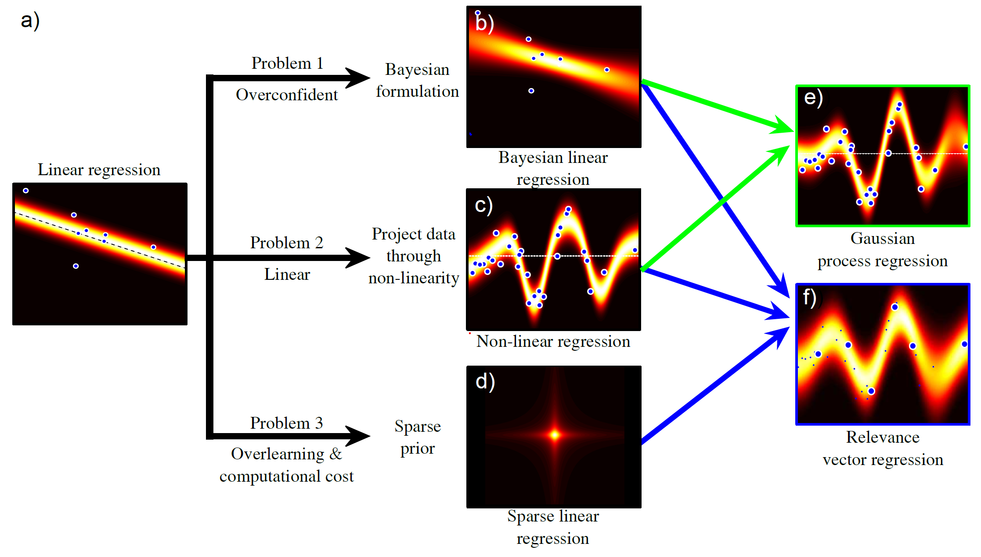
Regression Models
Computer vision: models, learning and inference. ©2011 Simon J.D. Prince
4

Slide 5
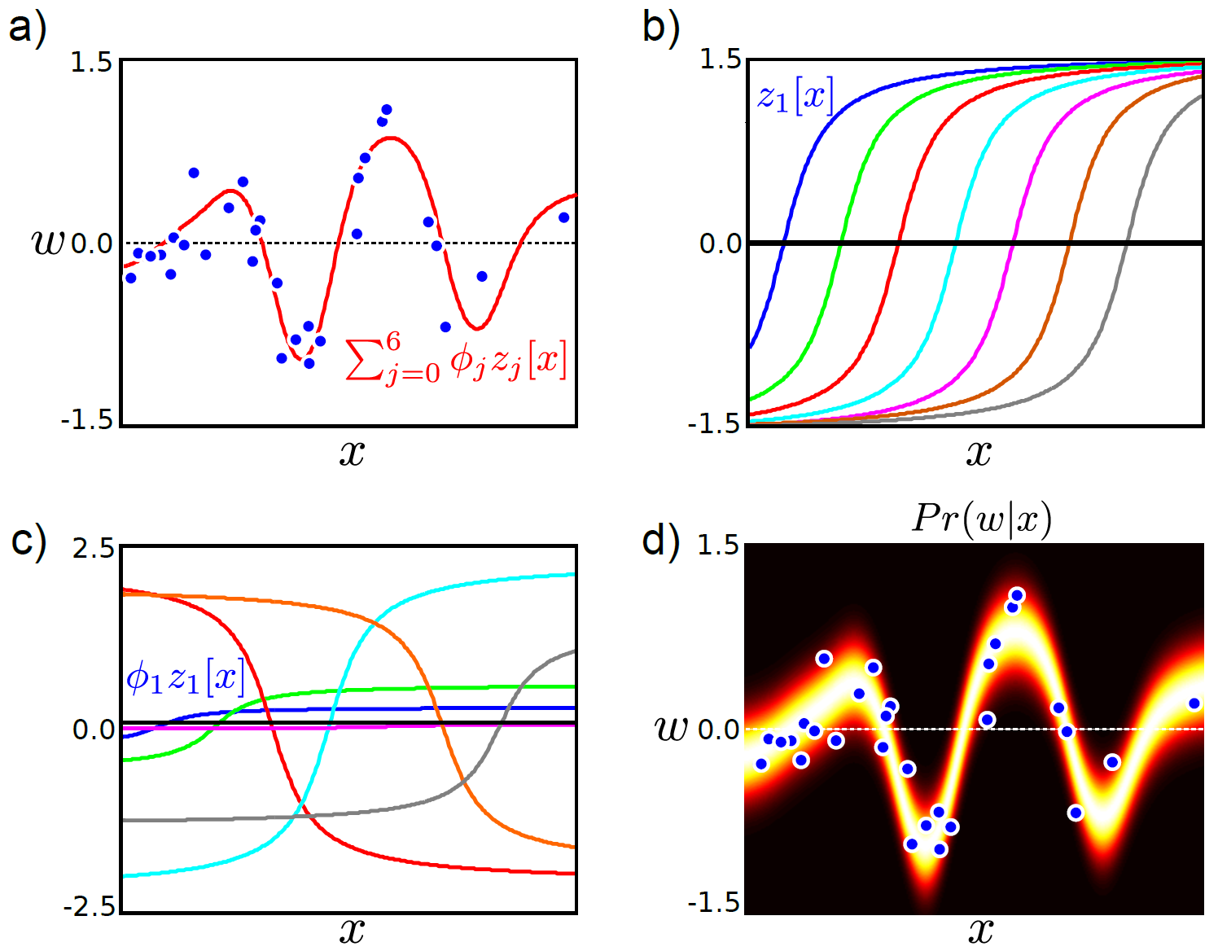
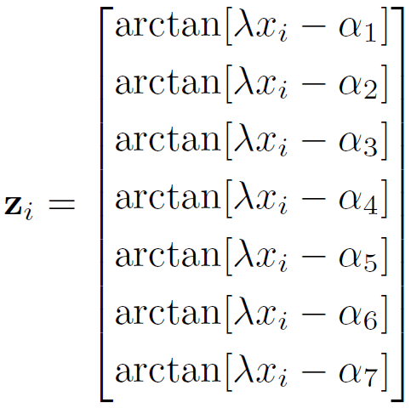
Arc Tan Functions
Computer vision: models, learning and inference. ©2011 Simon J.D. Prince
5

Slide 6
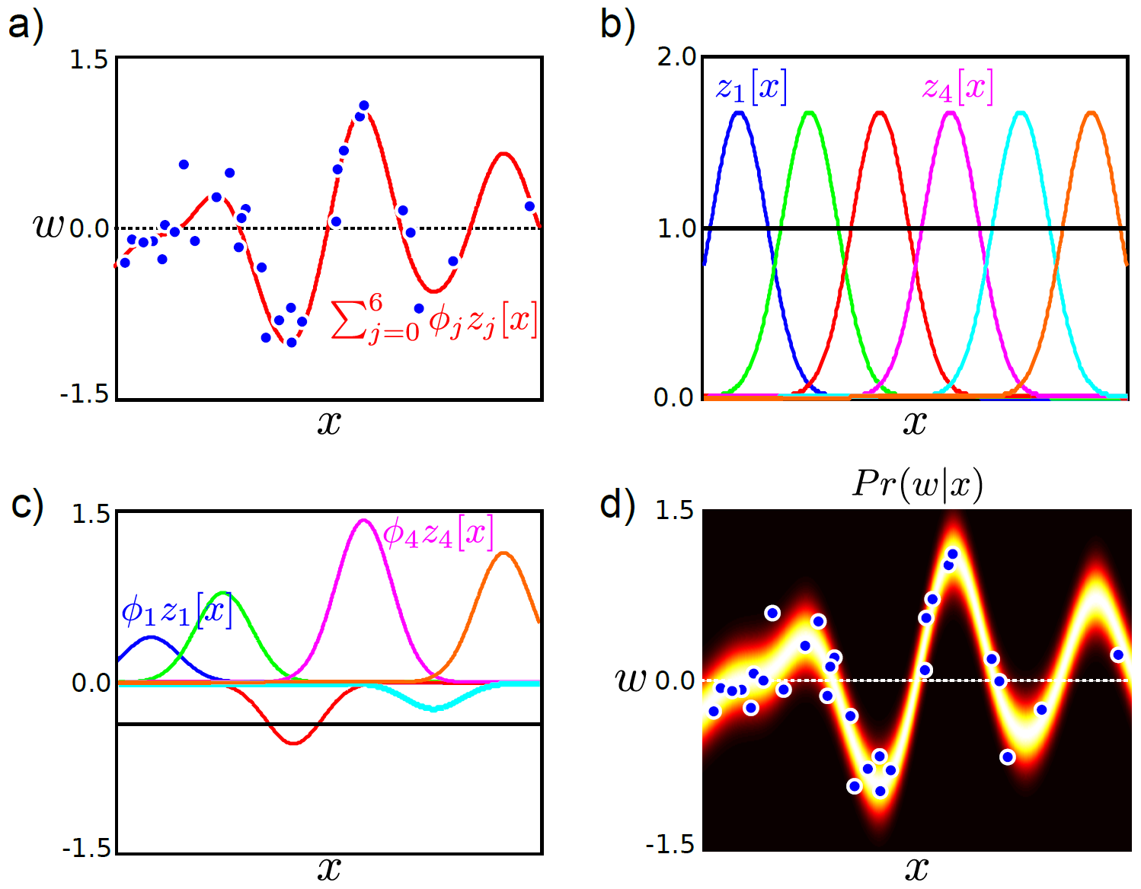
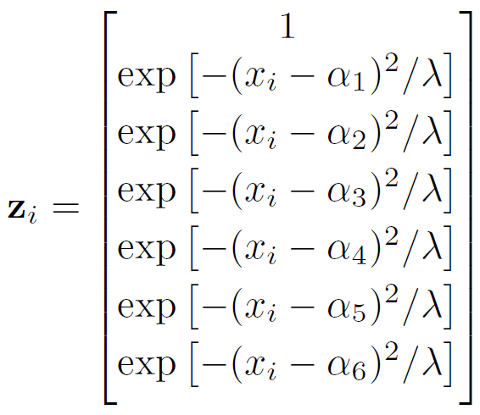
Radial basis functions
Computer vision: models, learning and inference. ©2011 Simon J.D. Prince
6

Slide 7
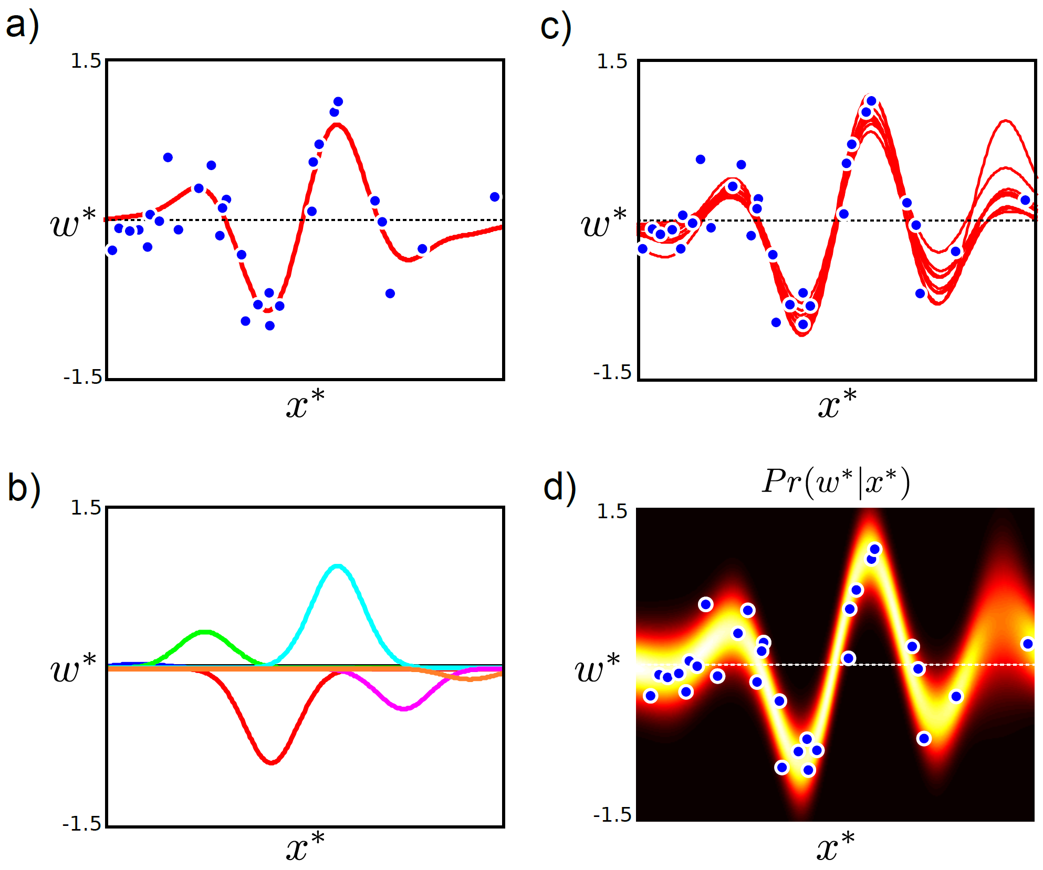
Computer vision: models, learning and inference. ©2011 Simon J.D. Prince
7

Slide 8
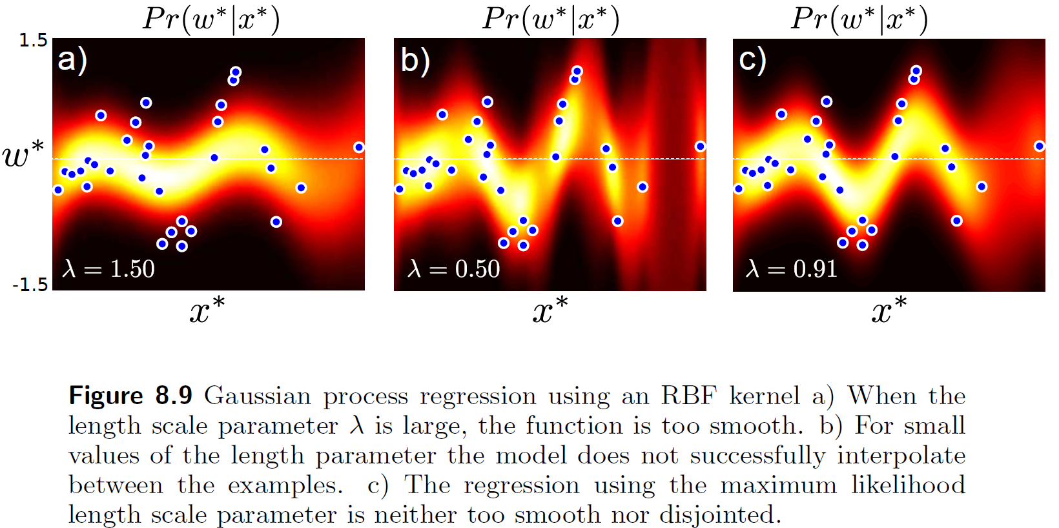
RBF Kernel Fits
Computer vision: models, learning and inference. ©2011 Simon J.D. Prince
8

Slide 9
Curve Fitting Re-visited

